Slide 1
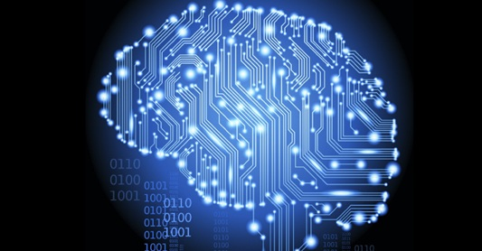
Toward the IoT era enabled by AI
김녹원
lwk@komosys.com
lwk@khu.ac.kr

Slide 2
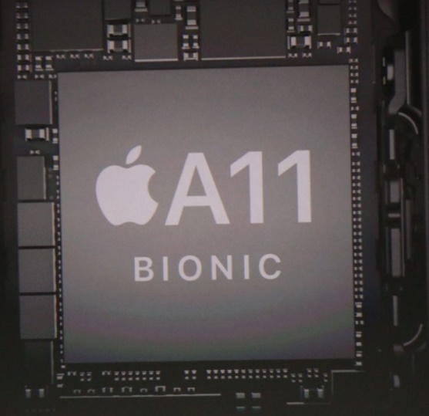
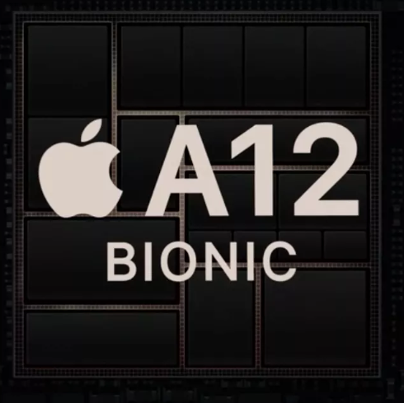
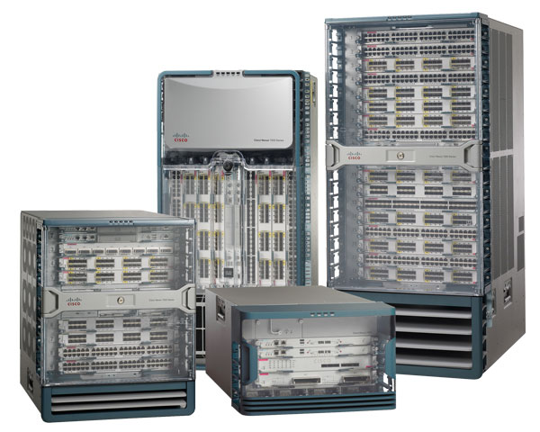
Lokwon Kim, Ph.D
Apple, Cupertino, CA
System-on-Chip (SoC) Platform Engineer (Advanced Engineer) Oct/2014 ~ April/2017
- Led design, verification, and prototyping of Application Processors used in iPhone, iPad, Apple Watch, etc.
- Created FPGA based prototypes and emulation systems using Palladium for SoC design verification
- Brought up and verified the operating system (iOS) and various software functions on SoC prototypes.
Cisco Systems, San Jose, CA
SoC ASIC Design Engineer (Staff Engineer) July/2011 ~ Oct/2014
- Led modelling and evaluation of system level architectures for next-generation network processing engine.
- Designed system HW architecture and integrated high-speed HW interfaces.
- Led design, verification, and prototyping of SoCs for next-generation network switch/router core chipsets.
- Brought up and verified the operating system and various software functions on SoC prototypes.
Ph.D. in EE at UCLA in 2011
IBM T. J. Watson Research Center, Yorktown Heights, NY
Research Intern June/2010 ~ Sep/2010
- Led a research project on computational acceleration for deep learning.
Broadcom, Irvine, CA
Research Intern June/2008 ~ Mar/2009
- Led research on automated C-to-RTL synthesis design methodology for wireless modem designs
Korea Electronics Technology Institute 전자부품연구원 (병역특례)
Project lead and research (Alternative military service ) June/2008 ~ Mar/2009
- Led a joint research project including KETI, LG, and Infineon for UWB (Ultra Wide Band) baseband SoC.
02

Slide 3
Introduction
03

Slide 4
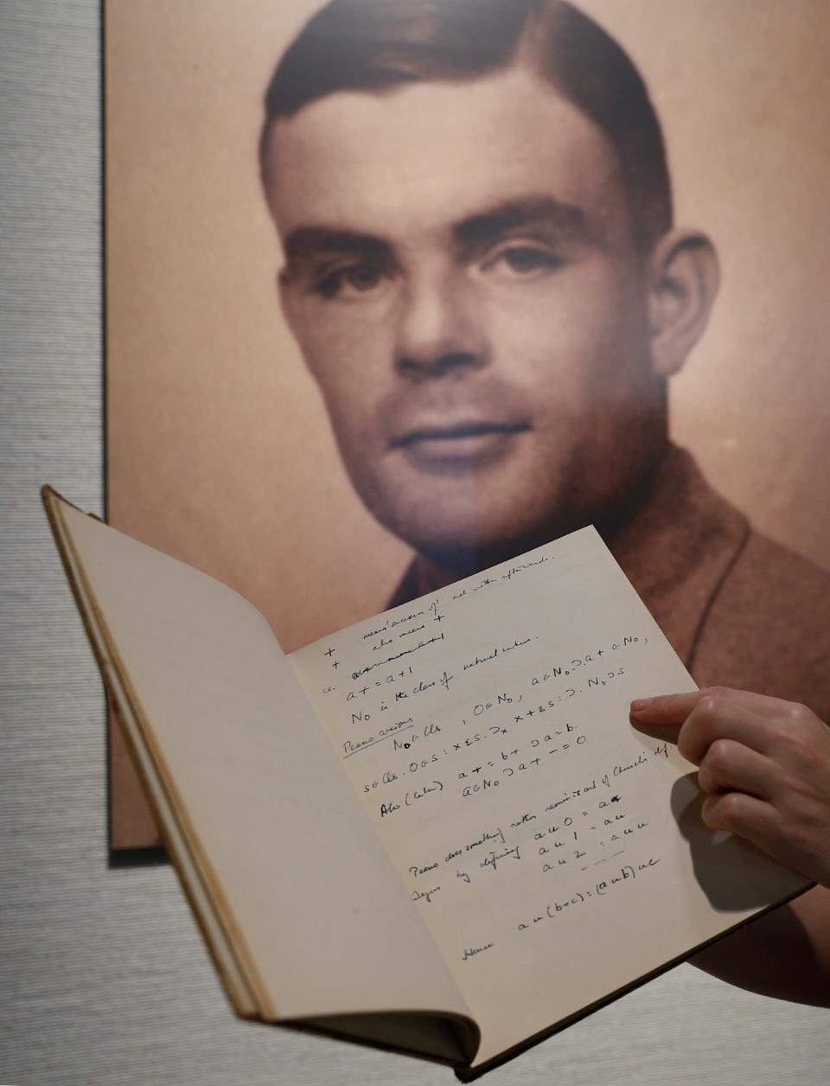
Alan Turing said in 1947
February 20, 1947
Alan Turing gives a talk at the London Mathematical Society in which he declares that “What we want is a machine that can learn from experience.”
A page from the notebook of British mathematician and pioneer in computer science Alan Turing, the World War II code-breaking genius, is displayed in front of his portrait during an auction preview in Hong Kong Thursday, March 19, 2015. (AP Photo/Kin Cheung)
04

Slide 5
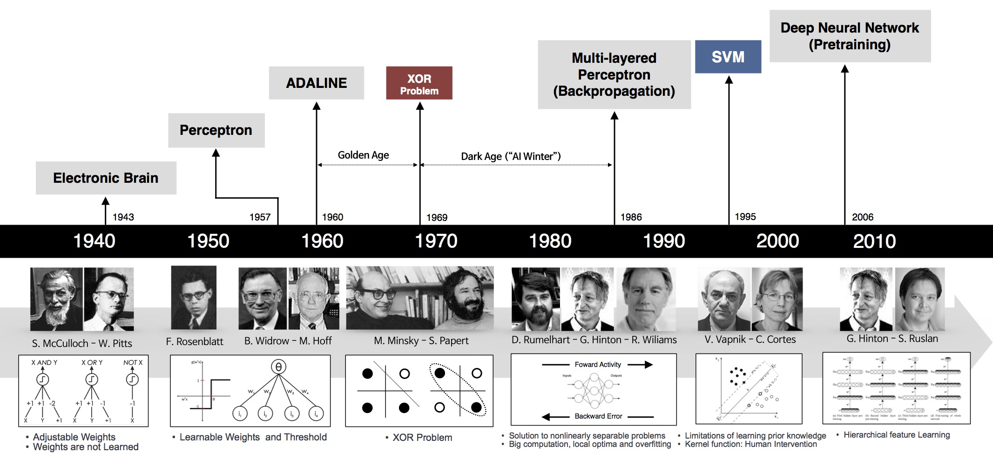
Brief History of Artificial Neural Networks
05

Slide 6
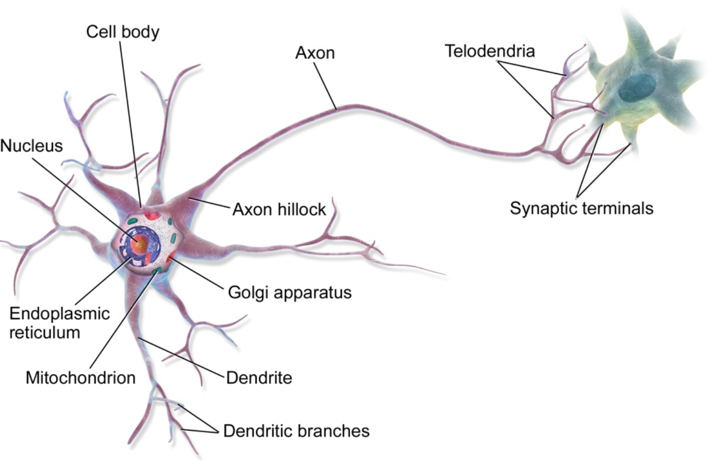
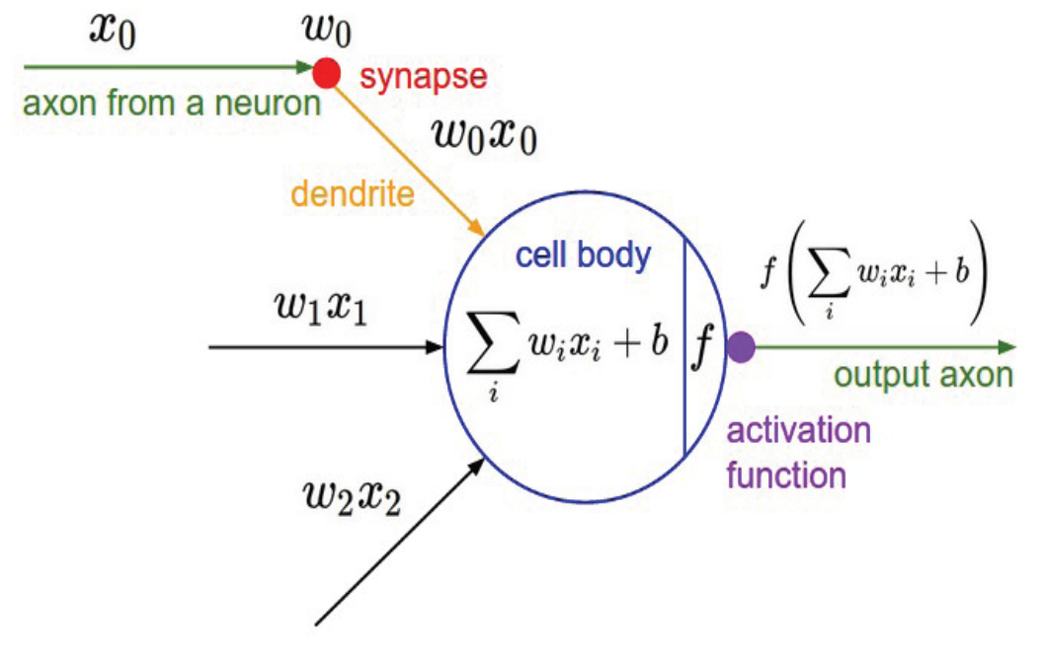
Artificial Neural Networks
Simplified
Model
06

Slide 7
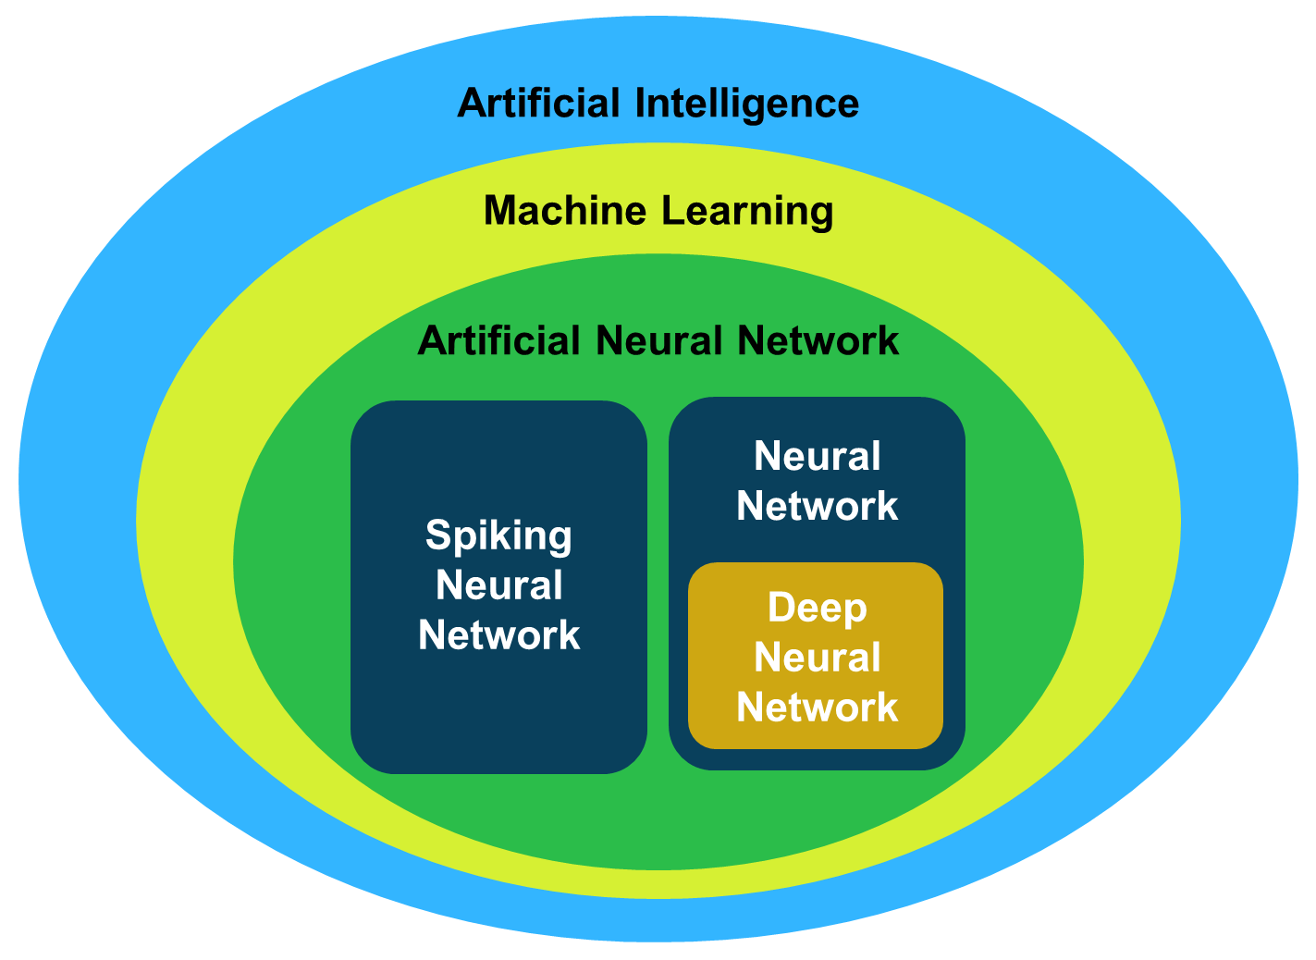
AI taxonomy
07

Slide 8
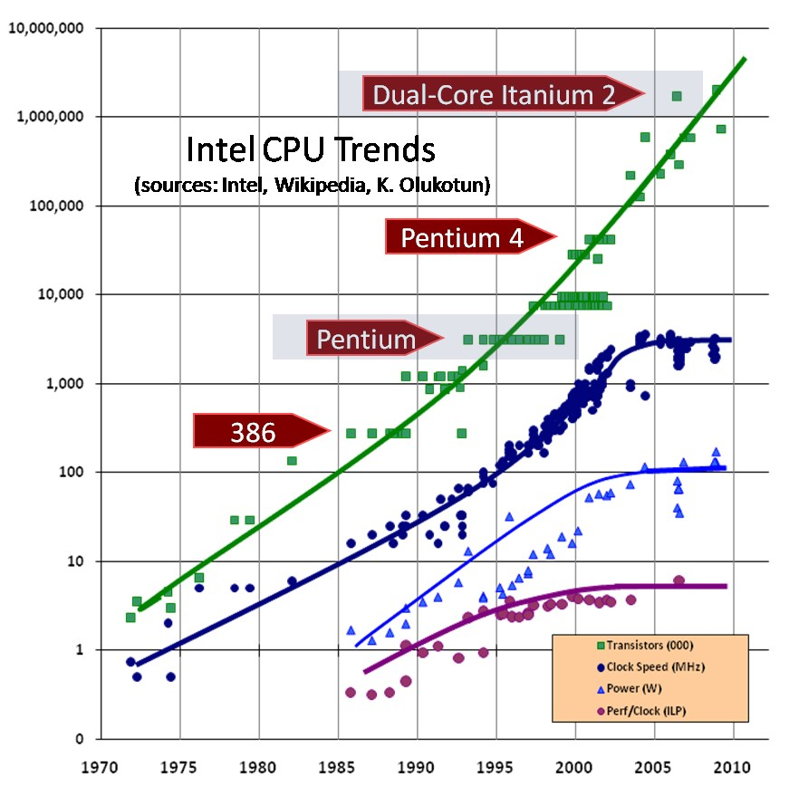
Moore’s Law
The number of transistors in a dense integrated circuit doubles about every two years.
08

Slide 9
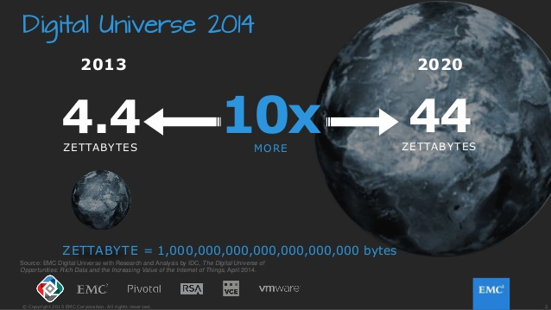
Data size increases
The size of data created worldwide is explosively increasing!
09

Slide 10
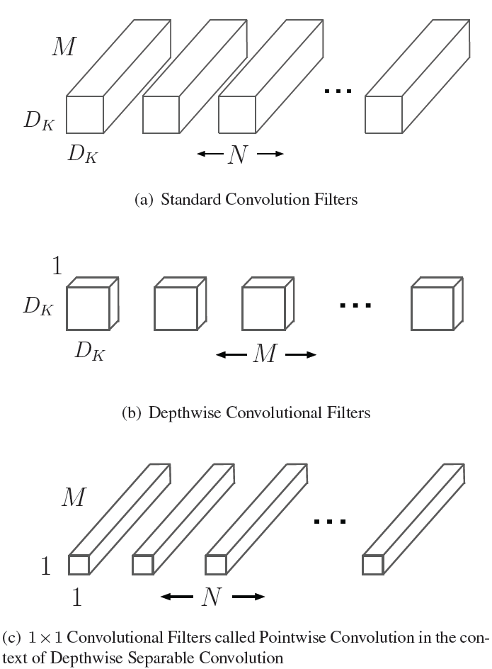
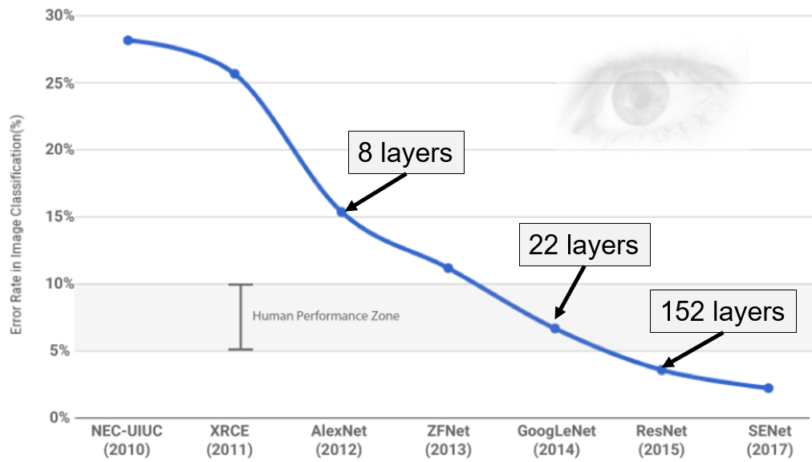
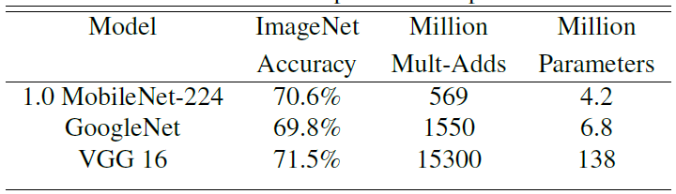
MobileNet
The deeper the better
Depthwise Separable Conv.
010

Slide 11
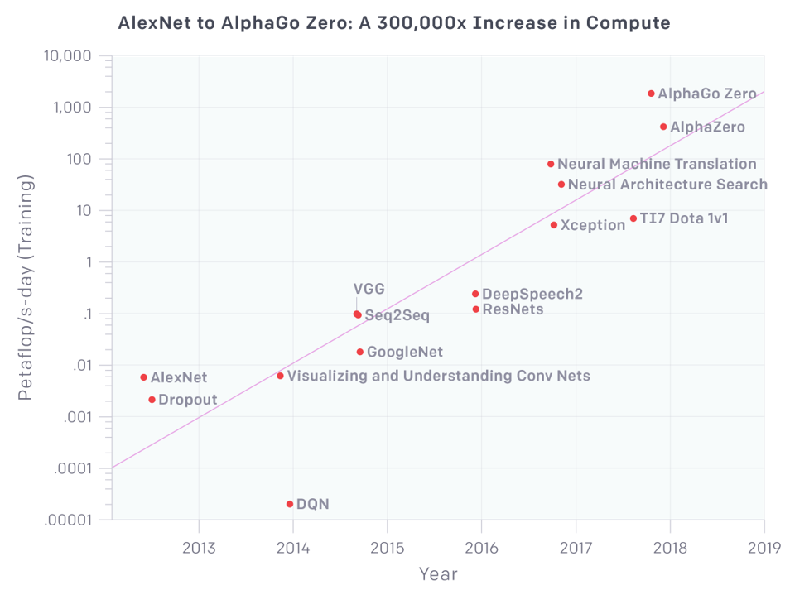
Exponential growth in algorithm complexity
Computation requirement has been exponentially increased!
011

Slide 12
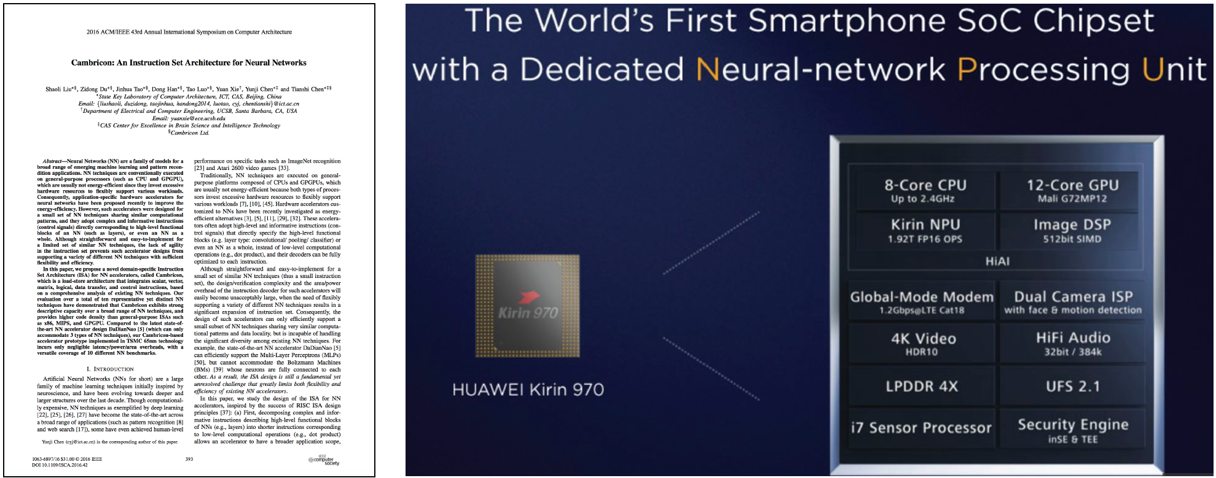
Cambricon
012

Slide 13
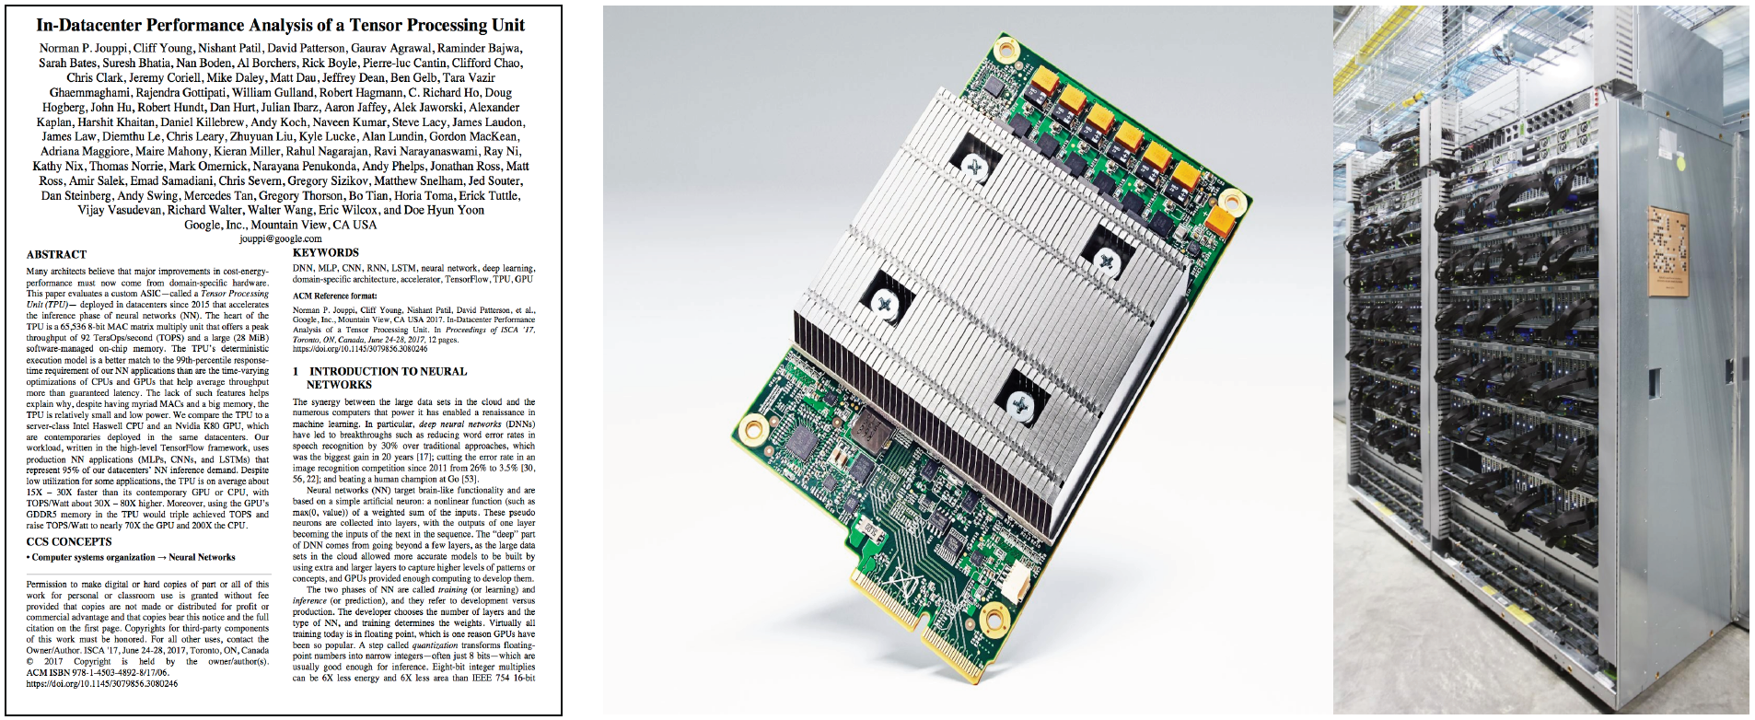
Google
013

Slide 14
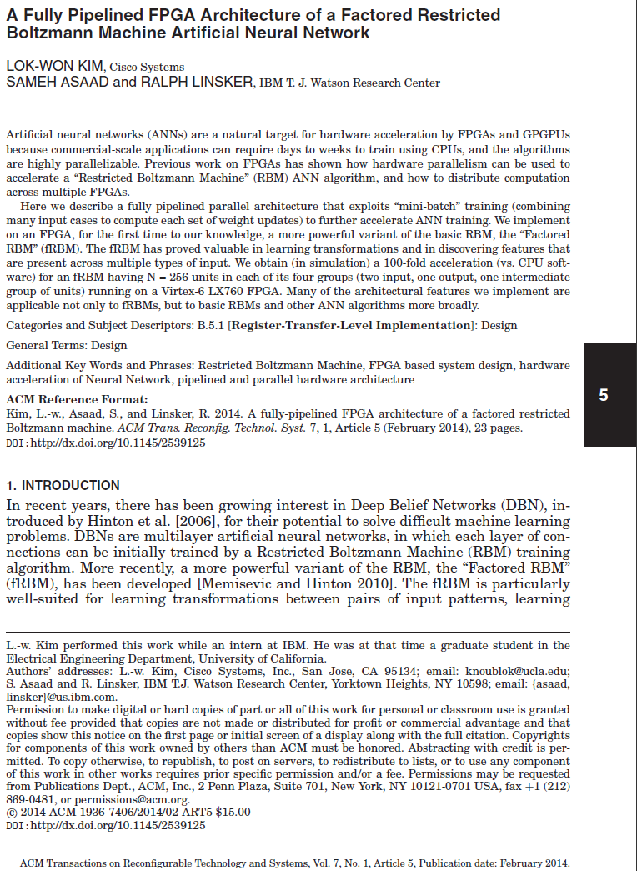
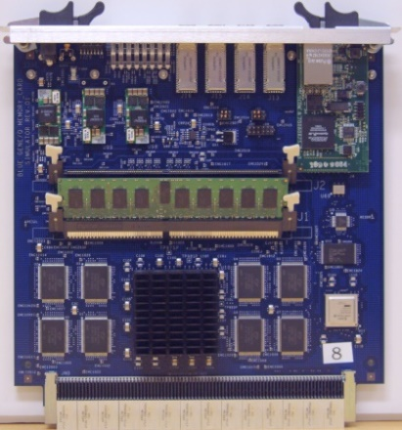
Previous work: Deep Learning Accelerator
014

Slide 15
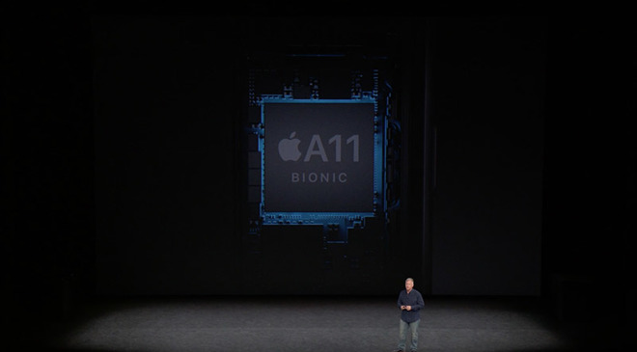
Previous work: Apple A11 Bionic
Source: Apple
015

Slide 16
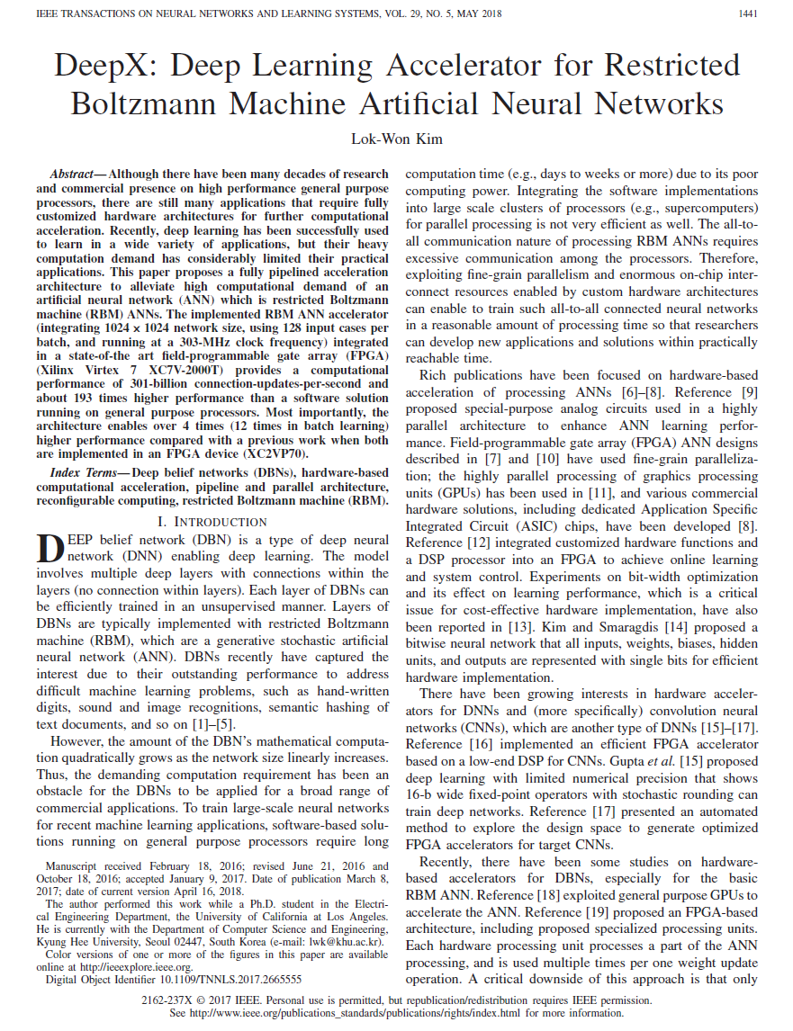
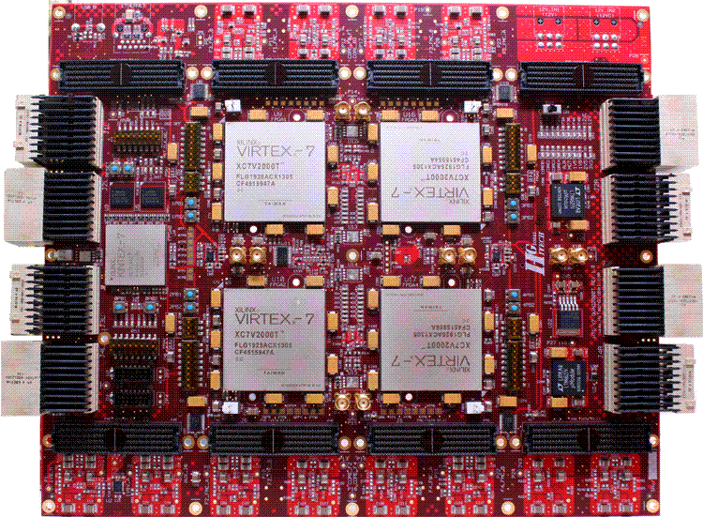
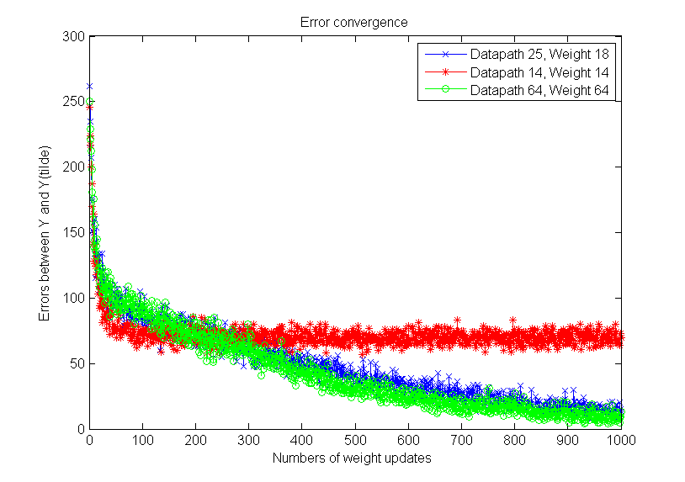
Previous work: DeepX
016

Slide 17
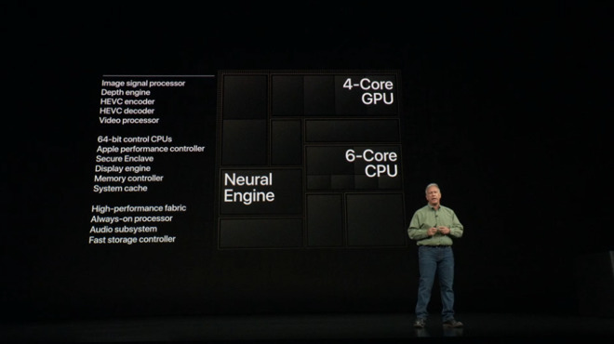
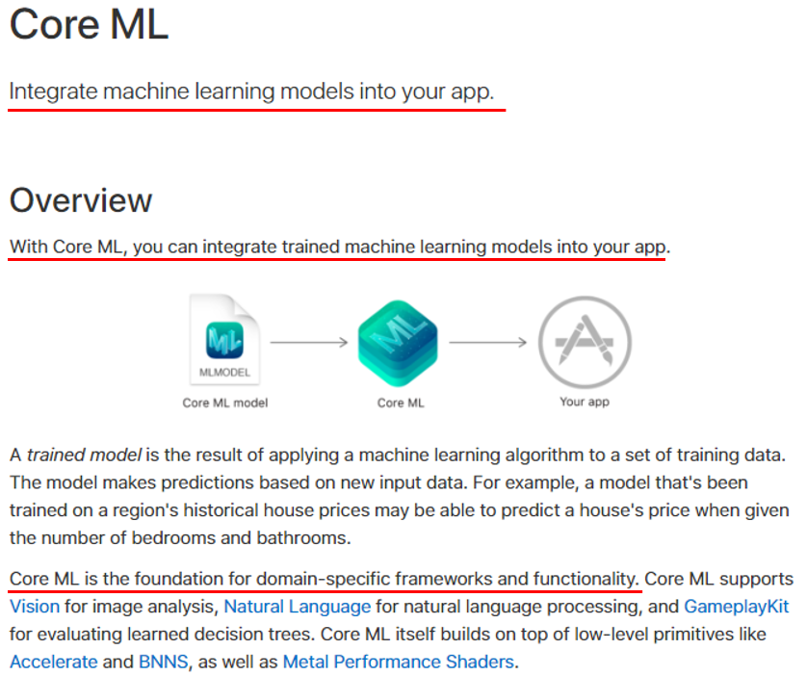
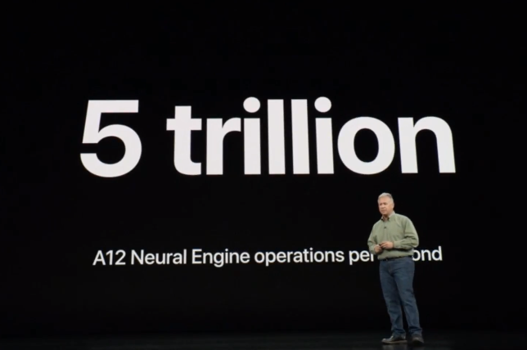
Previous work: A12 Bionic Neural Engine
Source: Apple
017

Slide 18
Hardware Platforms for AI
018

Slide 19
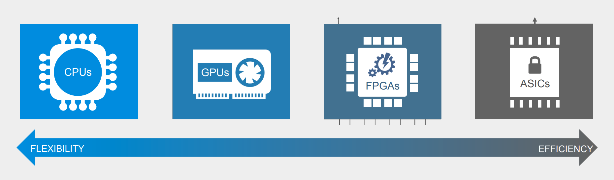
HW platform alternatives
Tradeoffs
Flexibility
Processing Performance
Learning
Energy Efficiency (Thermal Efficiency)
Cost
019

Slide 20
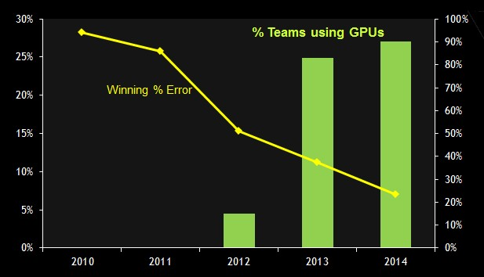
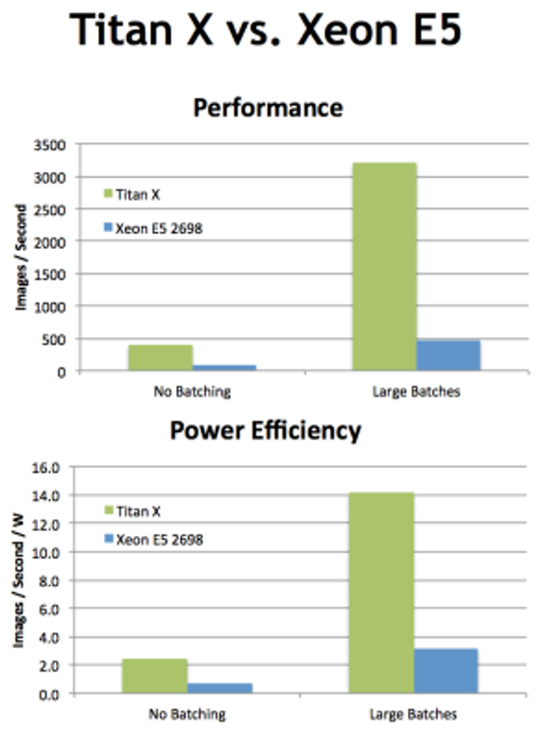
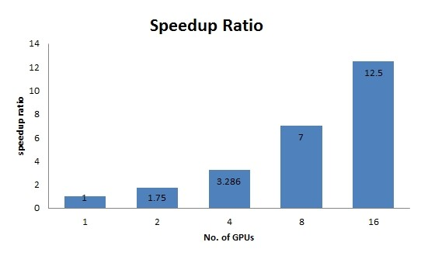
GPU vs CPU for deep learning of global datasets
020

Slide 21
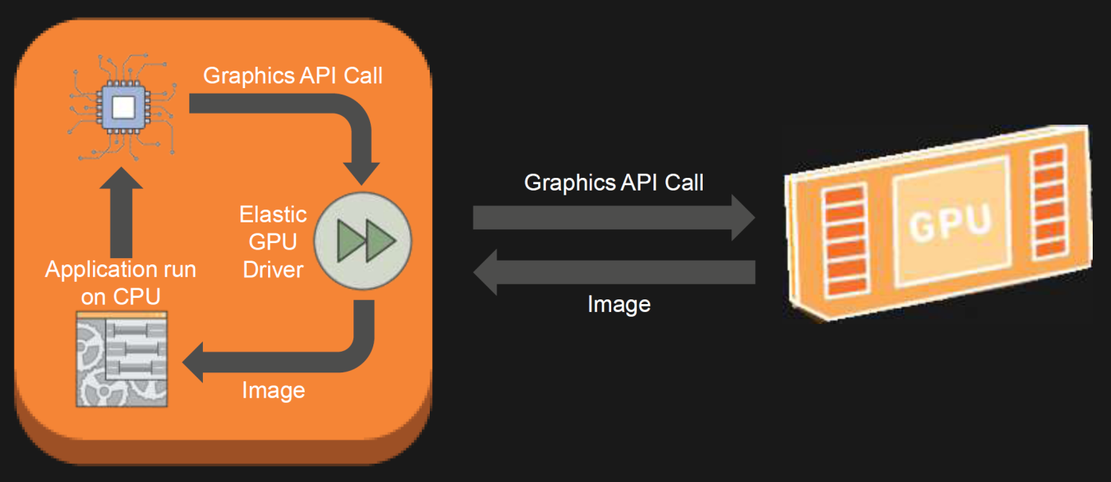
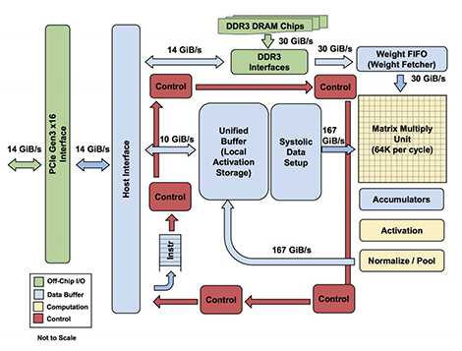
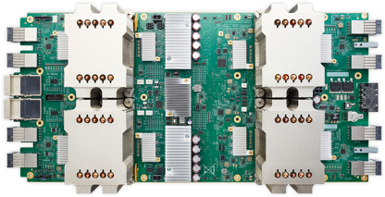
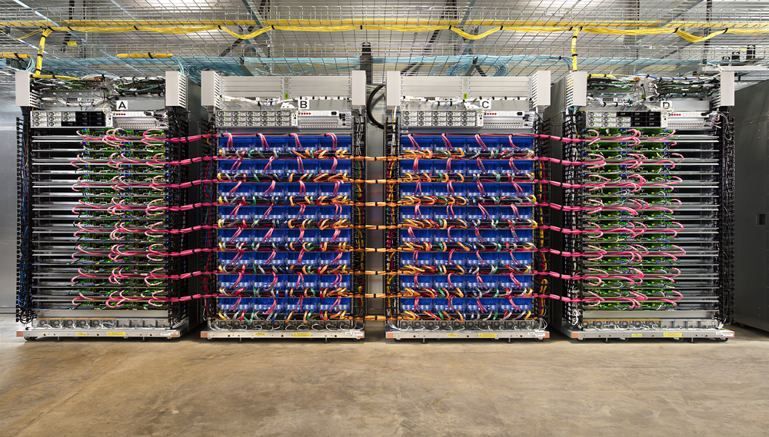
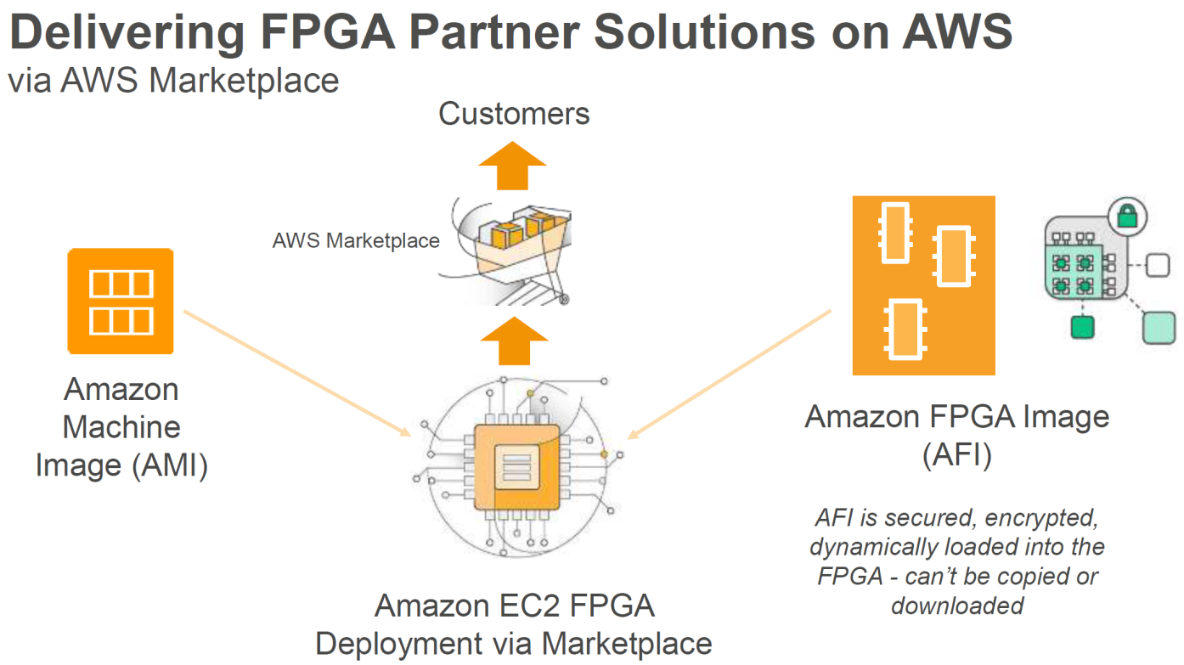
Cloud migration (CPU-> GPU -> ASIC/FPGA)
Google - Tensor Processing Unit
Source: GOOGLE
021
Source: Google
Source: AWS

Slide 22
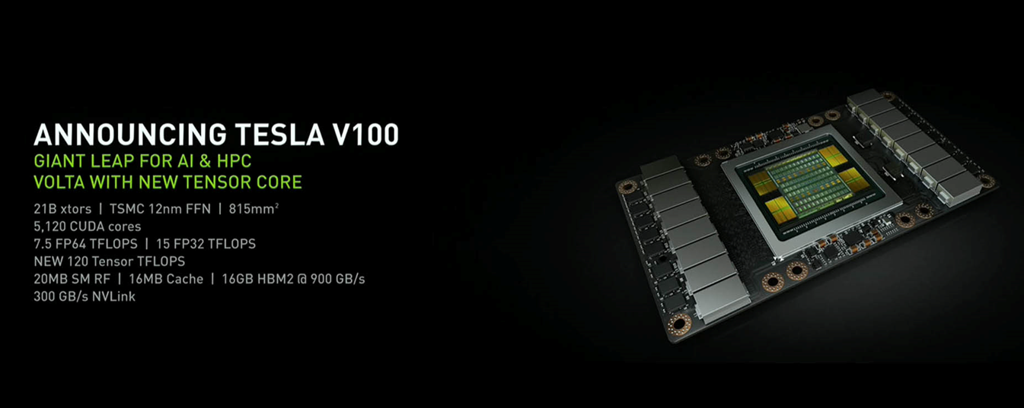
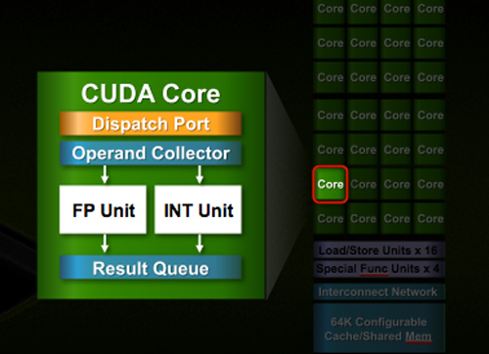
GPU architecture
Source: Nvidia
NVIDIA GPUs integrate thousands of CUDA cores.
CNN deep learning models utilize the massive parallel processing units.
022

Slide 23
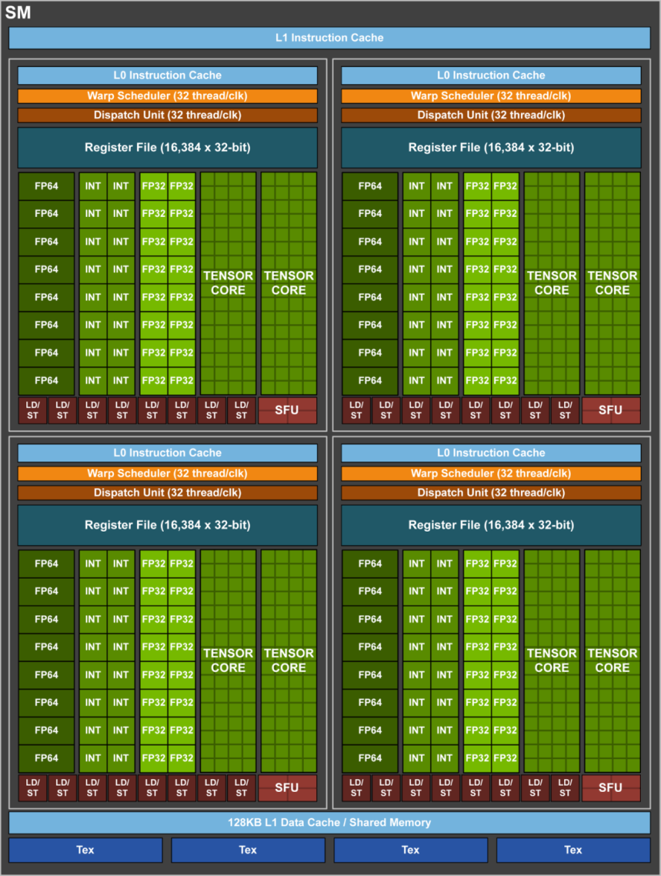
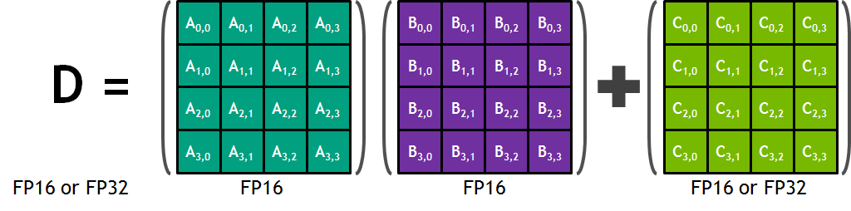
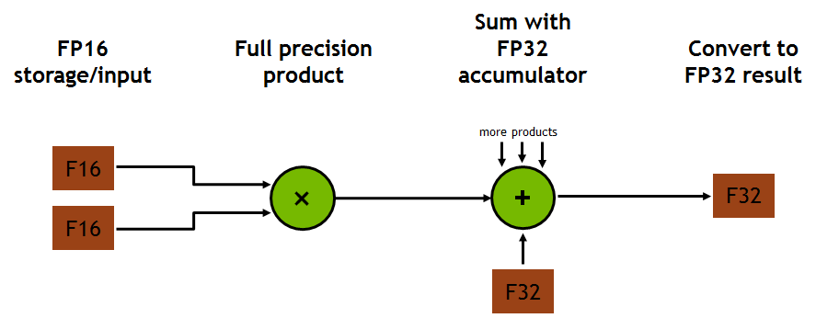
GPU architecture
4x4x4 matrix multiply and accumulate in Volta
Volta GV100 Tensor Core operation
Source: Nvidia
New VOLTA GPUs integrates new processing units dedicated for tensor operations (Tensor cores).
023

Slide 24
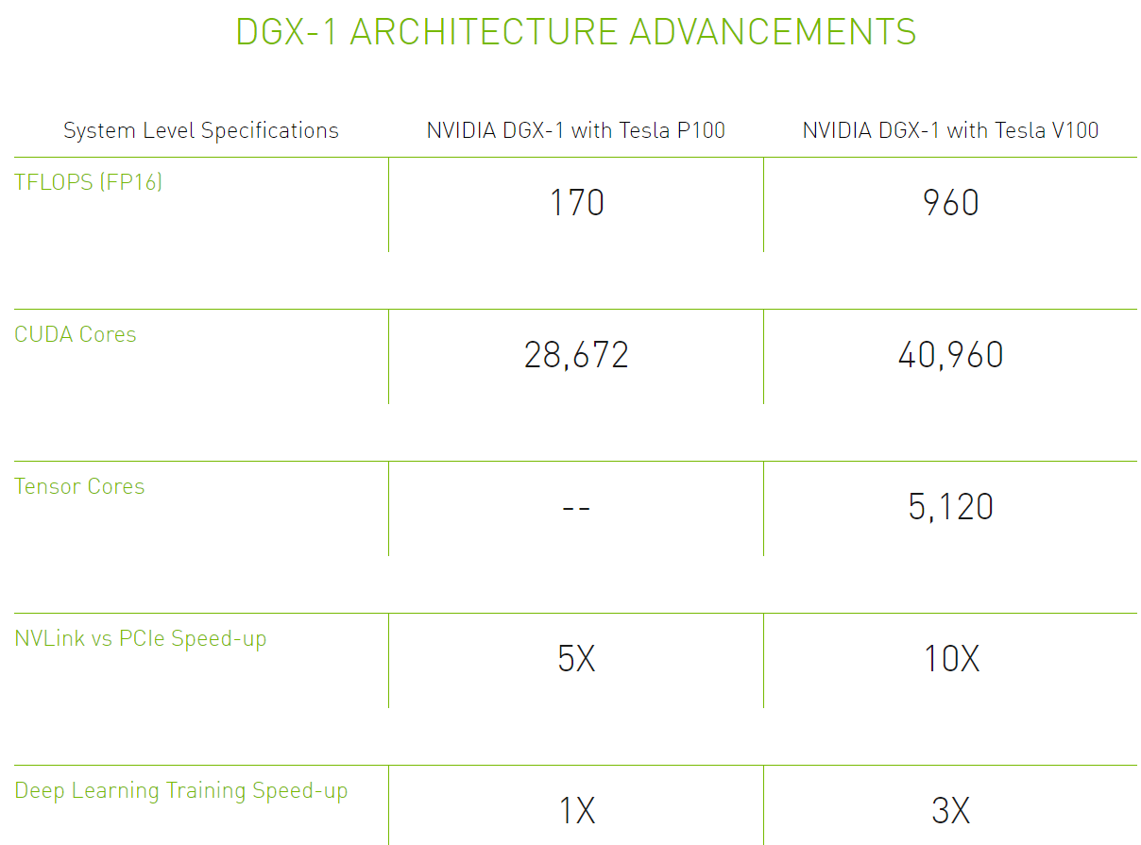
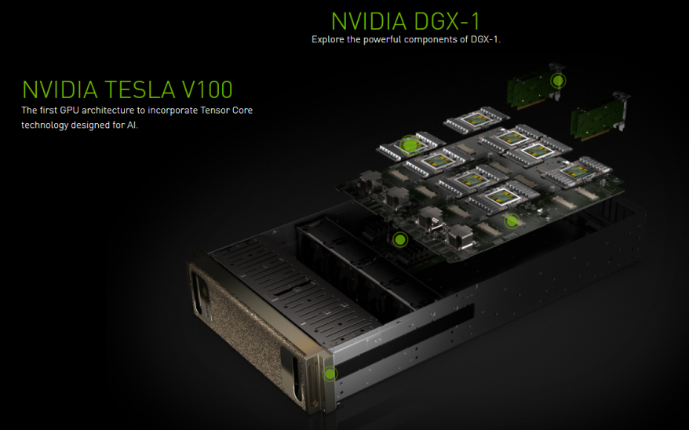
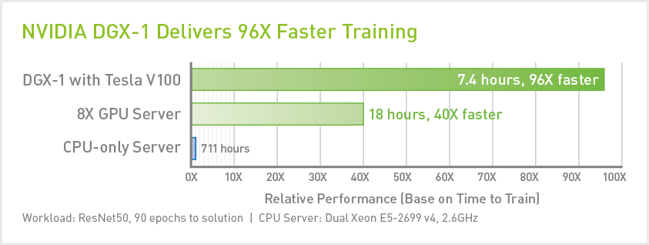
Digit Dev Box and DGX-1
Source: Nvidia
DGX-1 provides 96X performance than Dual Xeon processors.
024

Slide 25
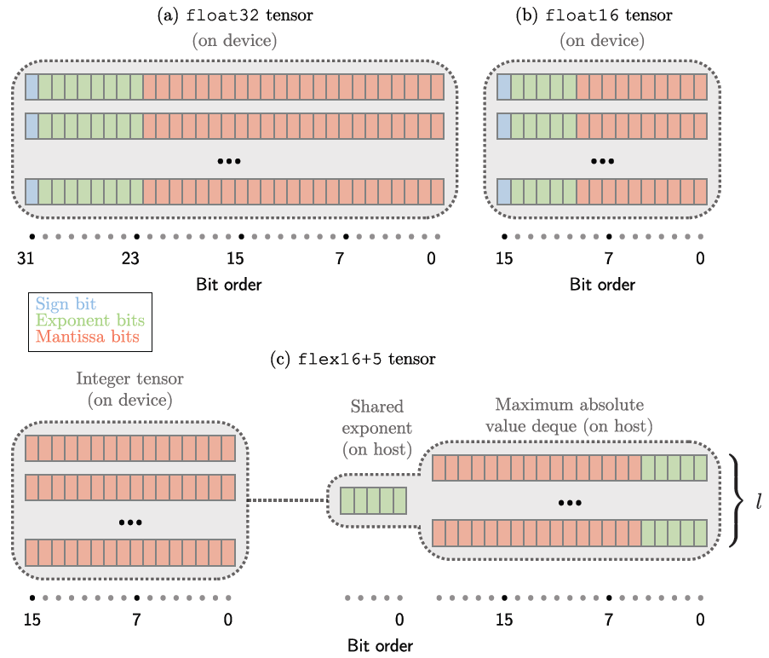
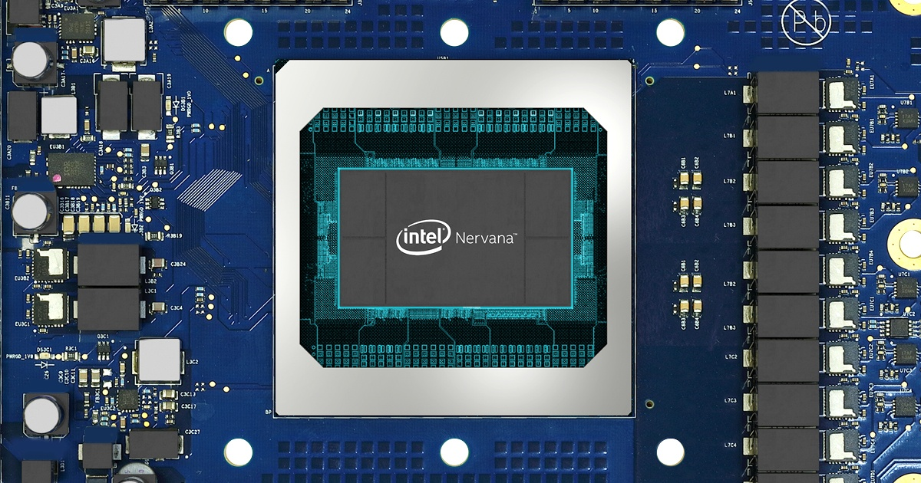
Intel NNP
Shared exponent saves bit widths of parameters
Source: Intel
Nervana has been merged by INTEL with $400M.
Intel NNP is powered by HBM supporting up to 1TB/s of bandwidth.
025

Slide 26
Neural Processing for Edge
Devices
026

Slide 27
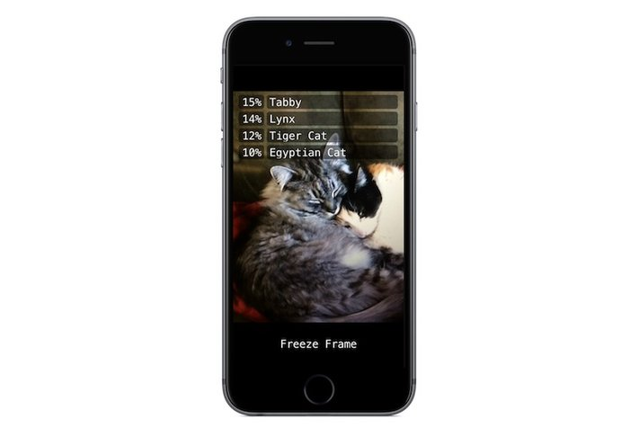
SW platform: Tensorflow Lite
Train on the server
Inference on the mobile
027

Slide 28
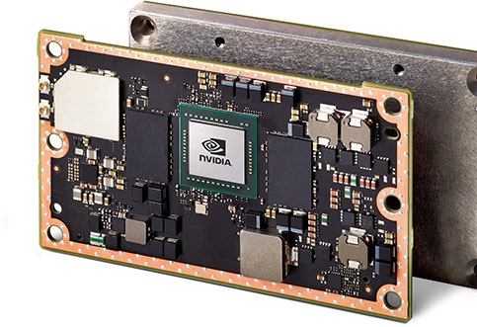
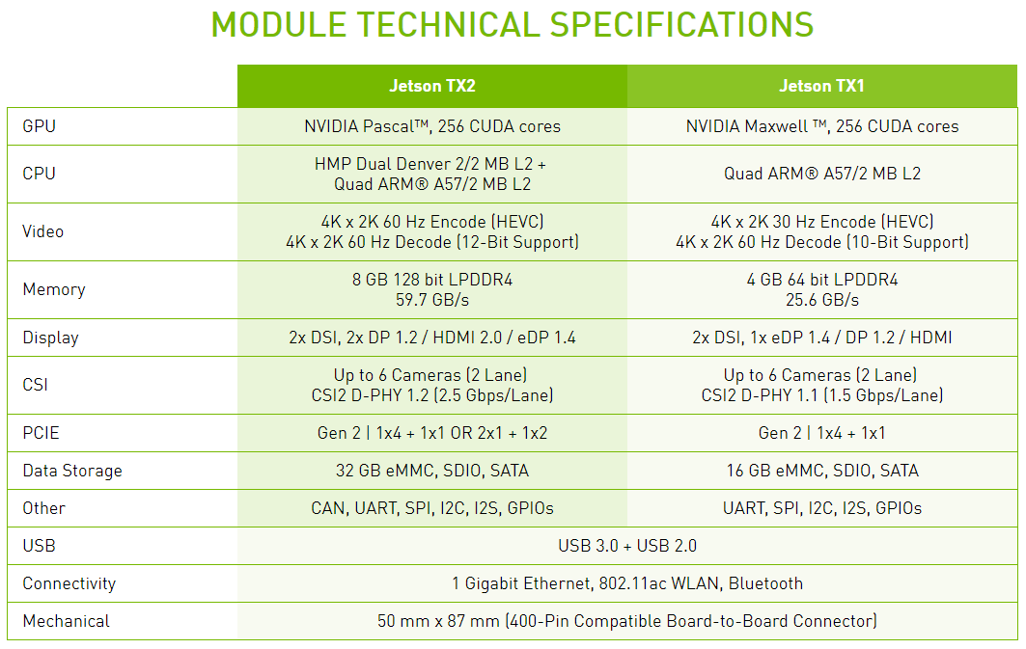
Nvidia JETSON
Source: Nvidia
NVIDIA has provided an AI chipset for embedded applications with reduced numbers of CUDA cores.
028

Slide 29
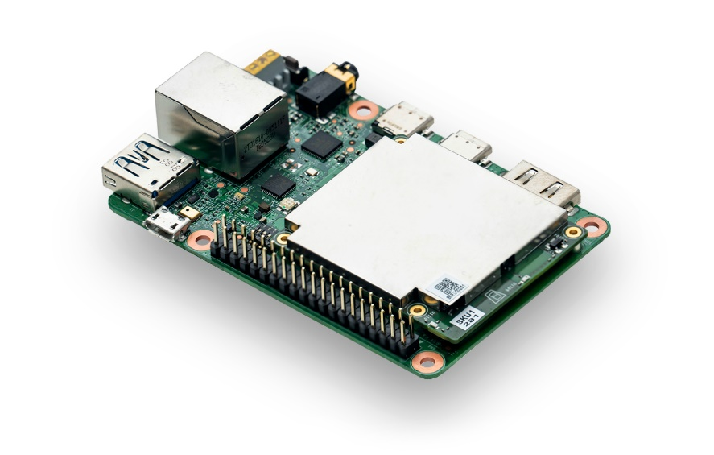
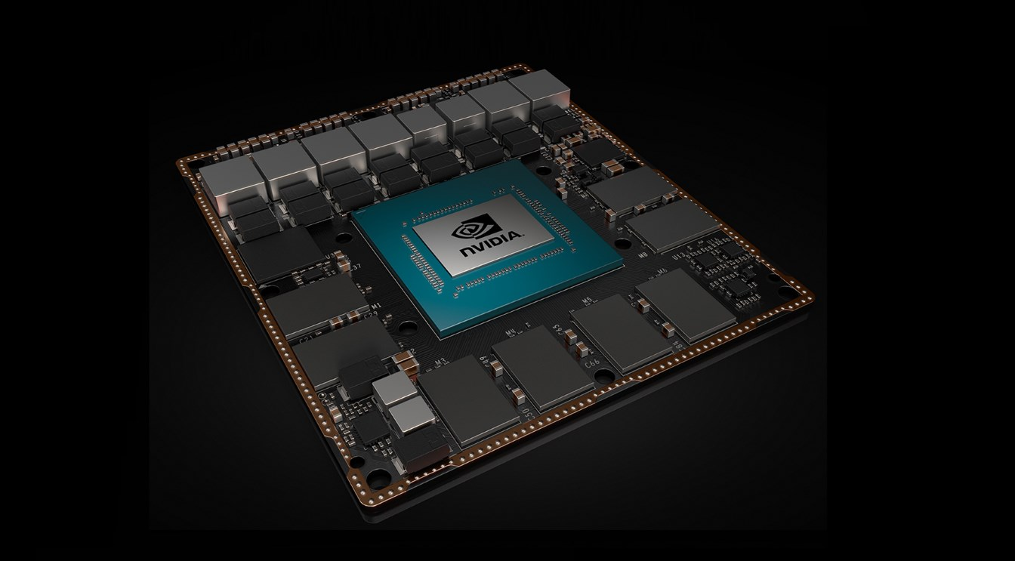
Google vs Nvidia conflict just in Edge Devices?
Edge TPU (Google)
Jetson Xavier (Nvidia)
Google and NVIDIA have been good partners but now become competitors.
Recent Tensorflow conflict → What does it mean?
029

Slide 30


Nvidia Drive Xavier
Source: NVIDIA
NVIDIA has provided an GPU based chipset for the self driving vehicle application.
030

Slide 31

Nvidia Drive Xavier
Source: NVIDIA
031

Slide 32

Nvidia Drive Xavier
Source: NVIDIA
032

Slide 33

Nvidia Drive Xavier
Source: NVIDIA
033

Slide 34


Intel Go
Source: Intel
034

Slide 35


Xilinx DeepHi
Source: Xilinx DeepHi
035

Slide 36
Previous work: Apple A11 Bionic
Source: Apple
036

Slide 37
Previous work: A12 Bionic Neural Engine
Source: Apple
037

Slide 38


Previous work: A12 Bionic Neural Engine
Source: Anand Tech
038

Slide 39
Apple AP power efficiency
Smartphones | # of CPUs | Operating Frequency | Main mem size
iPhone | Dual core | 1.4Ghz | 1 GB
A사 제품#1 | Quad core | 2.5Ghz | 2 GB
A사 제품#2 | Quad core | 2.3Ghz | 3 GB
B사 제품 | Quad core | 2.3Ghz | 2 GB
Apple hardware processor technology provides about 4 times higher power efficiency in AP processing.
039

Slide 40
Apple AP power efficiency
Characteristics | PCM | RRAM | STT-MRAM
Reads | 100 ~ 300ns | 30ns ~ 2us | 2 ~ 20ns
Writes | 10 ~ 150us | 100ns ~ 2us | 2 ~ 20ns
Read Energy | Low | Very Low | Low
Endurance | 10⁸ | 10¹⁰ | 10¹⁵
Density | Medium | High | Low
Cost | Medium | High | High
Apple hardware processor technology provides about 4 times higher power efficiency in AP processing.
040

Slide 41

Huawei Kirin 980
Source: Huawei
041

Slide 42


Qualcomm NPU
Source: QUALCOMM
Qualcomm is preparing application processors including Neural Processing Unit for Android smartphones.
Expected to release 2018 or 2019?
042

Slide 43

ARM DYNAMIQ
Source: ARM
ARM adds new instructions dedicated for AI operation.
043

Slide 44

ARM Project Trillium
Source: ARM
044

Slide 45




DL enabled SoCs
Hisilicon SoC
Ambarella SoC
Nvidia Drive PX2
Many companies including start-ups compete in the DL enabled SoC market for embedded applications.
045

Slide 46
Consideration Points
대부분 소프트웨어 스택을 통해 여러 알고리즘이 구동 가능한 프로세서 아키텍처를 가지고 있다.
다양한 응용 분야들은 각기 다른 연산 성능을 요구함.
각 응용 분야에서는 가용할 수 있는 전력 소모량이 상이함.
딥러닝 모델은 계속해서 진화하고 있는데, 이들을 효율적으로 구동시키는 프로세서 아키텍처.
소프트웨어 플랫폼과 호환성/이식성이 좋은 하드웨어 프로세서 솔루션 공급자의 부재 (구글/애플)
Applicable for limited applications
Chip vendors are releasing updated versions every year.
046

Slide 47
One more thing.
AI to the far edges!
047

Slide 48




The winner was ….
AlphaGo vs. Human Brain
# of Transistors: 10¹²
Power Consumption: 1 MW
# of Synapses : 10¹⁵
Power Consumption : 20W
전력 효율성과 집적도를 극대화한 딥러닝 프로세서 필요
048

Slide 49


IoT and AI
70B
Connected devices by 2025
180ZB
Generated by connected devices in 2025
Low Power
Deep Learning Solution
Source: IDC
2025년 까지 IoT 디바이스의 개체수는 700억이 것이라고 IDC 전망
IoT 디바이스의 센서를 통해 발생되는 데이터 양이 방대
예: Ford GT는 50개 센서와 28개 마이크로프로세서가 시간당 100GB 데이터 생산
사람의 지능을 대신해 저전력으로 데이터 분석, 동작 결정을 할 솔루션 필요!
© 2018 All Rights Reserved

Slide 50
Vision
알파고와 이세돌 구단의 바둑 대전
전력 소모 효율 개선 숙제
계속되는 무어의 법칙 행진
30년 후 백만 배 전력 효율
퀀텀 컴퓨팅
아날로그 뉴로모픽 컴퓨팅
알파고의 전력소모가 인건비 보다 낮게 됨
Singularity → 모든 산업 재편
4차 산업 혁명 완성
인간 수준의 인지능력 갖춘 700억 개의 IoT 디바이스 공존
인류가 역사상 보지 못한 사회로 도약
050

Slide 51



1. Low Power AI processor for Edge Devices
GPU server to Edge Devices
Architecture Simulator
설계된 가속 프로세서의 마이크로 아키텍처의 일부
FPGA 검증
A11 BIONIC
A12 BIONIC
Reference
- Lok-Won Kim “DeepX: Deep Learning Accelerator for Restricted Boltzmann Machine Artificial Neural Networks”, IEEE Transactions on Neural Networks and Learning Systems in 2018/May.
- Lok-won Kim; Sameh Asaad; Ralph Linsker “A Fully-Pipelined FPGA Architecture of a Factored Restricted Boltzmann Machine”, ACM Transactions on Reconfigurable Technology and Systems, Volume: 7, Issue: 1, Feb. 2014, Article No. 5)
051

Slide 52





2. Finding AI enabled new applications or functions
Drones
Self-driving Vehicles
Mind controlled robots
AR/VR HMD
AI 기술을 이용한 새로운 응용 분야에 적용 또는 새로운 기능 발굴
052

Slide 53


3. Improving Recognition Rate in Practical Approach
8 layers
22 layers
SSD 블록 다이어그램
152 layers
알고리즘 개선을 통한 인식률 트렌드
자율주행자동차 응용
알고리즘의 개선을 통한 인식률 향상은 한계에 도달, 실용적으로 인식률을 올리기 위한 새로운 방법이 필요!
053

Slide 54

4. Memory architecture for AI processing
딥 러닝에 최적화된 메모리 아키텍처 필요!
054

Slide 55
Q/A
Welcome technical intercourse and collaboration!
LWK@KOMOSYS.COM
055

